Slide 1


Foundations of
Scientific Computing
(SciComp 101)
Dave Biersach
dbiersach@bnl.gov
Session 25
Computational Chemistry

Slide 2
Session 25 – Goals
Identify an unknown element using the Ideal Gas Law
Use the method of least squares (created by Gauss) to find the line of best fit that passes through sampled data
Implement patterns to serialize and rehydrate a JSON data file as a Python Dictionary
Investigate the nuclear stability of Uranium
Leverage Open Data Sets to analyze the liquid range of the elements
Balance ionic chemical equations using linear programming

Slide 3
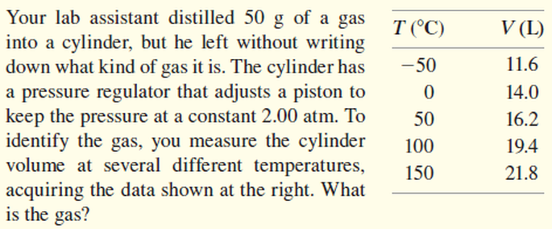
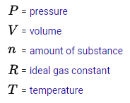
Identify an Unknown Element
From the 2015
NYS Chemistry Regents Exam
$$PV=nRT$$
SI Units
$$V=\left(\frac{nR}{P}\right)T$$
constant
pascals (Pa)
meters³
$$y=mx$$
constant
constant
$$V=\left(m\right)T$$
kelvin (K)
constant

Slide 4
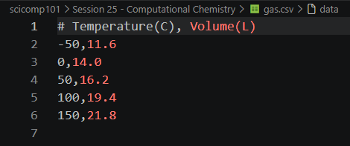
Open gas.csv
CSV = Comma Separated Value (a "text" file)
①

Slide 5
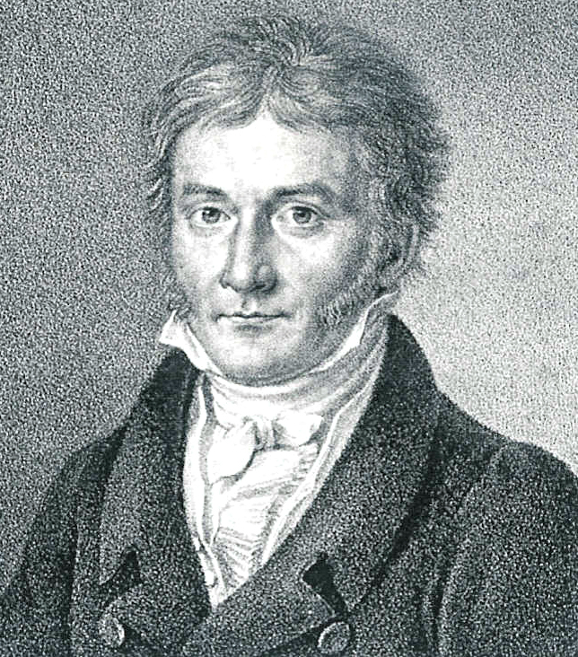
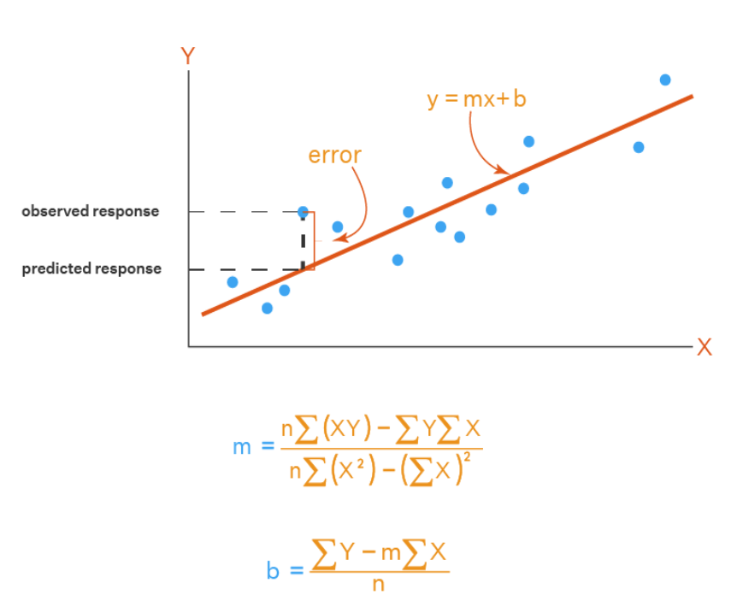
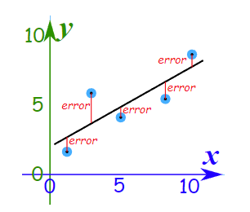
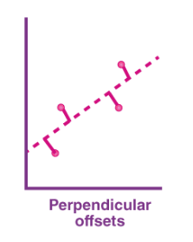
Method of Least Squares
Carl Friedrich Gauss
(1777-1855)

Slide 6
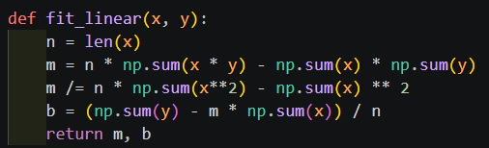

Open identify_element.py
①
②
③
④
⑤
⑥
$$y=mx+b$$

Slide 7
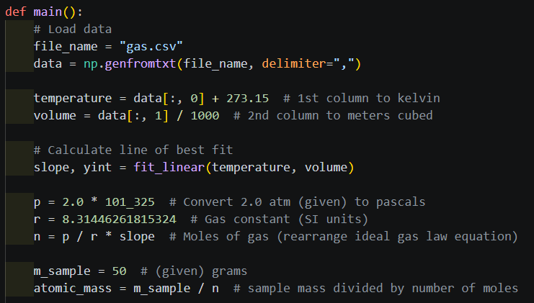



View identify_element.py
①
②
③
④
⑤
⑥
⑦
⑧
Slope of line of best fit
$$m=\frac{Δy}{Δx}=\frac{V}{T}$$
$$PV=nRT$$
$$n=\left(\frac{P}{R}\right)\left(\frac{V}{T}\right)=\frac{P}{R}\left(m\right)$$

Slide 8
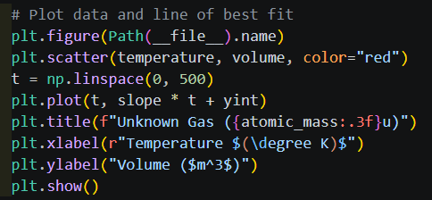

View identify_element.py
①
②
③
④
⑤
$$y=mx+b$$

Slide 9
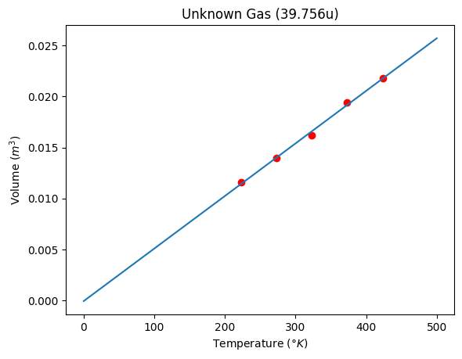
Run identify_element.py

Slide 10

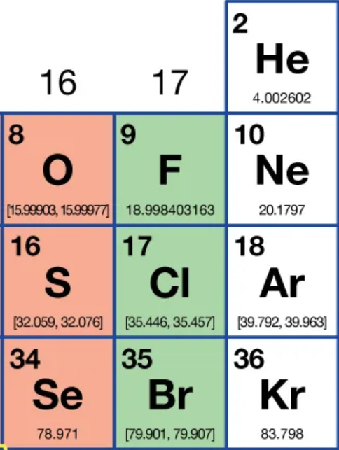
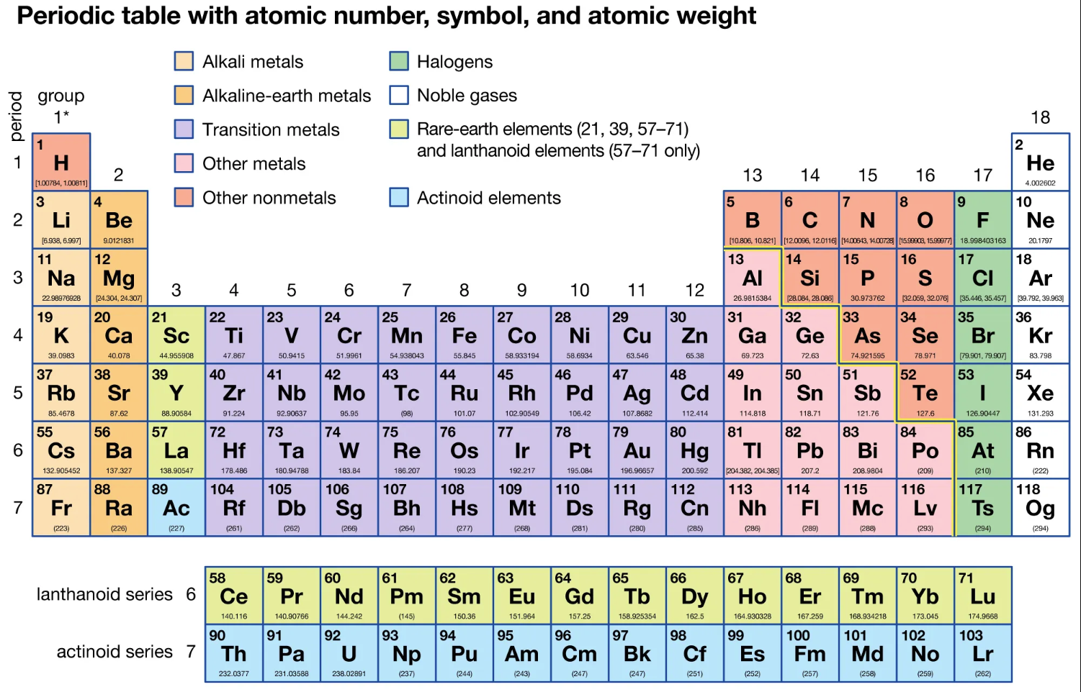

Slide 11

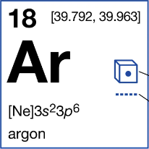
Run identify_element.py
Argon is the third-most-abundant gas in Earth's atmosphere
It is 2x more abundant than water vapor
It is 23x more abundant than carbon dioxide

Slide 12
Method of Least Squares
Carl Friedrich Gauss
(1777-1855)
Clearly, these formulas work as expected…
…but how did Gauss derive these formulas?

Slide 13
Method of Least Squares
Least
Squares
$$Minimize S= \sum_{i=1}^{n}{{\left[y_{i}−\left(mx_{i}+b\right)\right]}^{2}}$$
Slope-intercept form of a line
Let’s set aside the summation operator for now…
$$\left[y−(mx+b)\right]\left[y−(mx+b)\right]$$
$$(y−mx−b)(y−mx−b)$$
$$y^{2}$$
$$−mxy$$
$$−by$$
$$−mxy$$
$$+ m^{2}x^{2}$$
$$+bmx$$
$$−by$$
$$+bmx$$
$$+b^{2}$$
$$S=$$
$$y^{2}−2mxy−2by+m^{2}x^{2}+2bmx+b^{2}$$

Slide 14
Method of Least Squares
$$Minimize S= \sum_{i=1}^{n}{{\left[y_{i}−\left(mx_{i}+b\right)\right]}^{2}}$$
$$S=$$
$$y^{2}−2mxy−2by+m^{2}x^{2}+2bmx+b^{2}$$
For S to have a minimum, these two partial derivatives must exist:
$$\frac{∂S}{∂m}=0, \frac{∂S}{∂b}=0$$
$$\frac{∂S}{∂m}=−2xy+2mx^{2}+2bx=0$$
Divide out the 2’s
$$mx^{2}+bx=xy$$
Move any term not containing a $m$ or $b$ to the RHS
$$\frac{∂S}{∂b}=−2y+2mx+2b=0$$
$$mx+b=y$$

Slide 15
Method of Least Squares
$$Minimize S= \sum_{i=1}^{n}{{\left[y_{i}−\left(mx_{i}+b\right)\right]}^{2}}$$
$$S=$$
$$y^{2}−2mxy−2by+m^{2}x^{2}+2bmx+b^{2}$$
$$mx^{2}+bx=xy$$
$$mx+b=y$$
Recall that we know all the $x$ and $y$ values, so the values in parentheses are constant coefficients
$$\left(x^{2}\right)m+\left(x\right)b=\left(xy\right)$$
This is a system of 2 linear equations with 2 unknowns: $m$ and $b$
$$\left(x\right)m+\left(1\right)b=\left(y\right)$$
The values in parentheses should be summed per the original Sigma operator

Slide 16
Method of Least Squares
$$\left(x^{2}\right)m+\left(x\right)b=\left(xy\right)$$
$$\left(x\right)m+\left(1\right)b=\left(y\right)$$
$$\left(x^{2}\right)m+\left(x\right)\left[\frac{\left(y\right)−\left(x\right)m }{(1)}\right]=\left(xy\right)$$
$$\left(1\right)b=\left(y\right)−\left(x\right)m$$
$$b=\frac{\left(y\right)−\left(x\right)m }{(1)}$$
$$(1)\left(x^{2}\right)m+\left(x\right)\left[\left(y\right)−\left(x\right)m\right]=(1)\left(xy\right)$$
$$\left(1\right)\left(x^{2}\right)m+\left(x\right)\left(y\right)−{\left(x\right)}^{2}m =(1)\left(xy\right)$$
Recall we are using parentheses to remind us those coefficients represent sums
$$\left(1\right)\left(x^{2}\right)m−{\left(x\right)}^{2}m =\left(1\right)\left(xy\right)−\left(x\right)\left(y\right)$$
$$m\left[\left(1\right)\left(x^{2}\right)−{\left(x\right)}^{2}\right] =\left(1\right)\left(xy\right)−\left(x\right)\left(y\right)$$
$$m=\frac{\left(1\right)\left(xy\right)−\left(x\right)\left(y\right)}{\left(1\right)\left(x^{2}\right)−{\left(x\right)}^{2}}$$

Slide 17
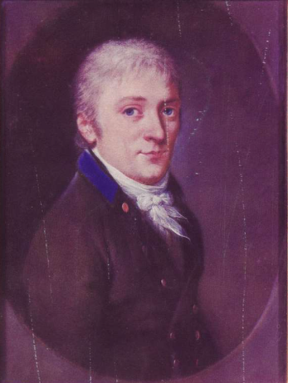
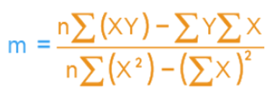
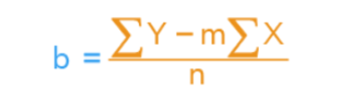
Method of Least Squares
$$m=\frac{\left(1\right)\left(xy\right)−\left(x\right)\left(y\right)}{\left(1\right)\left(x^{2}\right)−{\left(x\right)}^{2}}$$
$$b=\frac{\left(y\right)−\left(x\right)m }{(1)}$$
Recall all sums range from $1 to n$
$$\sum_{i=i}^{n}{ }$$
$$\sum_{i=i}^{n}{\left(1\right)}=n$$
$$m=\frac{n\sum{\left(xy\right)−\sum{y}\sum{x}}}{n\sum{x^{2}−{\left(\sum{x}\right)}^{2}}}$$
Gauss in 1795
He was 18 when he invented his method of least squares
$$b=\frac{\sum{\left(y\right)−m\sum{x}}}{n}$$
Recall $x$ represents all $x_{i}$ and $y$ represents all $y_{i}$

Slide 18
Isotopes
An isotope is a variant of the same element that shares the same number of protons (which defines the element) but differs in its number of neutrons — for example, Carbon-12 and Carbon-14 are both carbon, but C-14 has two extra neutrons
Neutrons act as a nuclear "glue" as they help offset the electrostatic repulsion between the positively charged protons packed together in the nucleus, and the strong nuclear force they contribute helps hold the nucleus together
There is a narrow stability band — for any given element, only certain neutron counts produce a stable or long-lived nucleus. Too few or too many neutrons throw off the balance, making the nucleus unstable and prone to radioactive decay
A one-neutron difference can shift a nucleus not just in how fast it decays but how it decays (alpha, beta, gamma, electron capture, etc.), since each mechanism is driven by different nuclear force imbalances, further contributing to wildly different observed half-lives

Slide 19
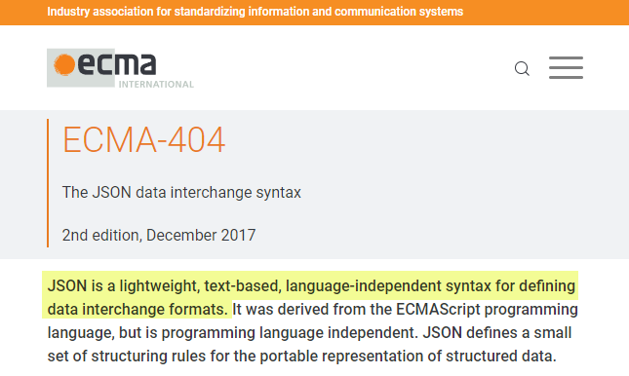
Python Dictionaries and JSON Data Files
JavaScript Object Notation (JSON)
"Key-Value Pairs"
https://www.json.org

Slide 20
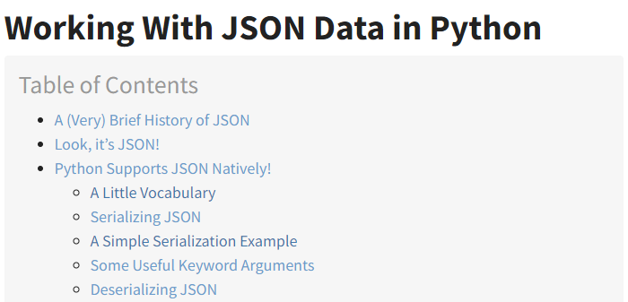
Python Dictionaries and JSON Data Files
JavaScript Object Notation (JSON)
"Key-Value Pairs"
https://www.json.org
https://realpython.com/python-json

Slide 21
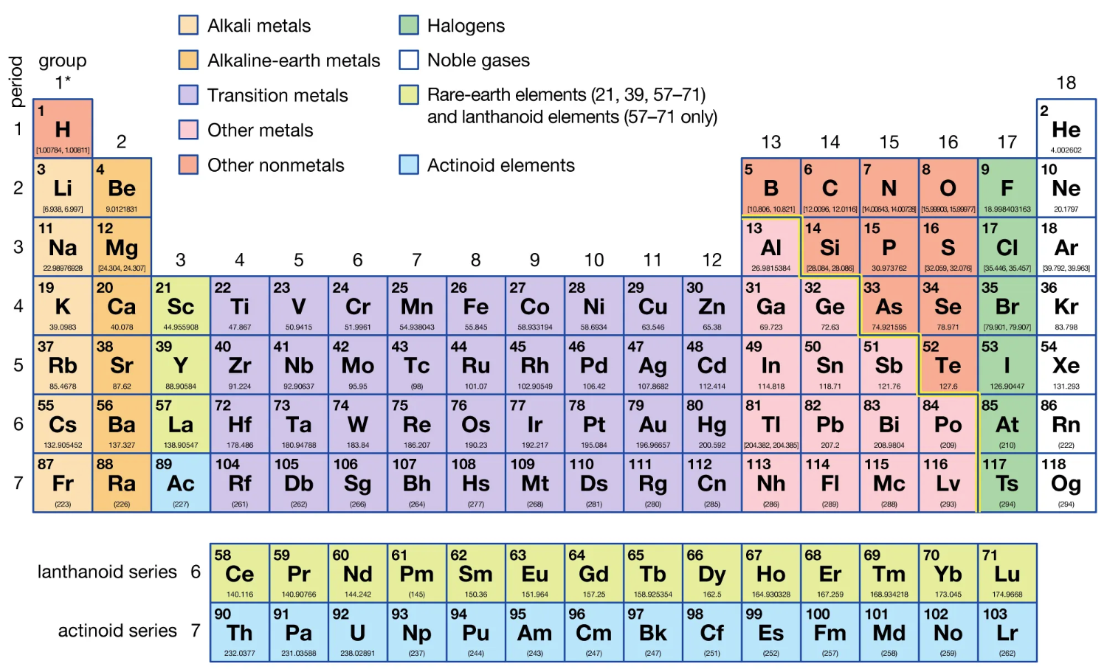
The Periodic Table (circa 2021)
U-238
# of Protons = 92
# of Neutrons = 146

Slide 22
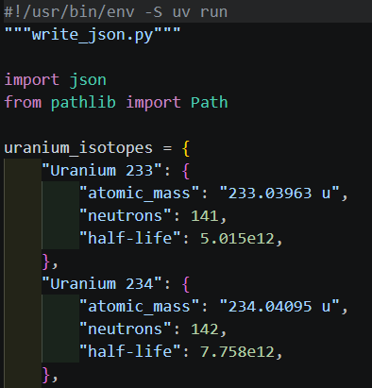
Open write_json.py
①
②
③
④
⑤
"Key-Value Pairs"

Slide 23
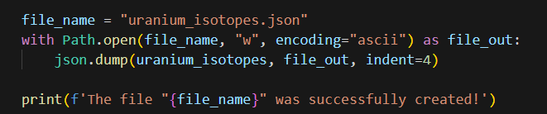
View write_json.py
①
②
③
④

Slide 24
Run write_json.py
①
②
③
④

Slide 25
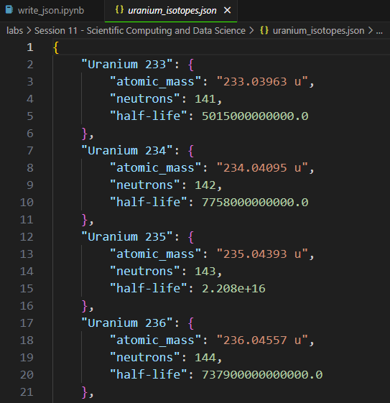
Open uranium_isotopes.json

Slide 26
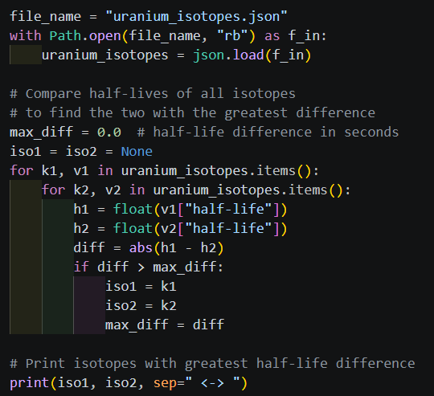
Open read_json.py
①
②
③
④
⑤
⑥
⑦
⑧
⑨
⑩

Slide 27
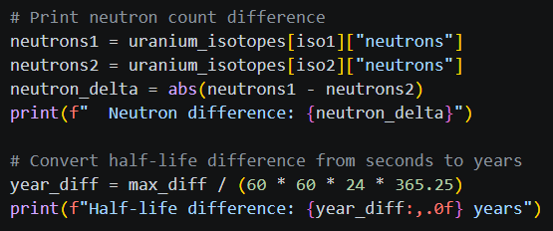
View read_json.py
①
②
③
④
⑤

Slide 28

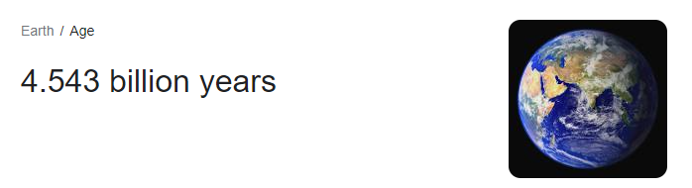
Run read_json.py
Which two isotopes of Uranium differ the most in half-life?
①
②
One tiny neutron can make a world of difference

Slide 29
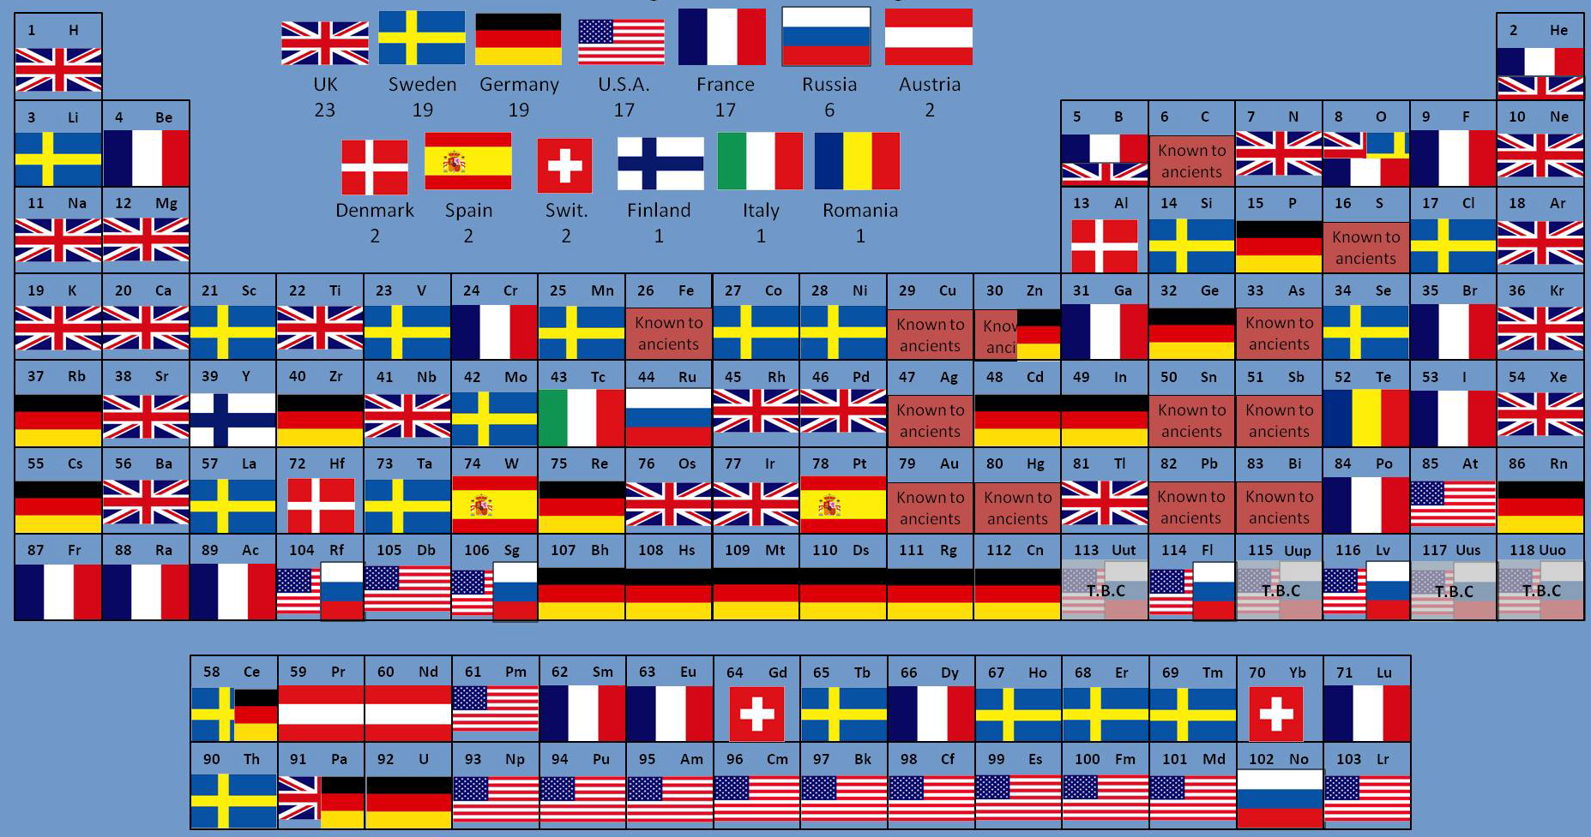
Elements By Country of Discovery

Slide 30
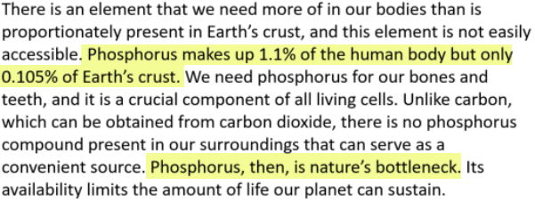
One Element
https://wou.edu/chemistry/courses/online-chemistry-textbooks
https://en.wikipedia.org/wiki/Adenosine_triphosphate (ATP)
https://en.wikipedia.org/wiki/Krebs_Cycle

Slide 31
"It's not what you look at that matters, it's what you see." Henry David Thoreau (1846)
Scientists have measured the various electrical impulses traveling up the major nerves stemming from our eyes, ears, nose, tongue, and skin that ultimately signal our brain
We have determined that more than 80% of our total sensory input comes from our eyes – we are an incredibly visual species
Humans do poorly at spotting trends in tabular data, whereas graphical charts enable us to sense trends and quickly spot anomalies
The boring old periodic chart is full of hidden and surprising art if we can find ways to better visualize the data

Slide 32
Liquid Range
Your scientist has asked you to plot the melting and boiling point of each element across the periodic chart
She is interested in visualizing any trends and discontinuities in elements having the same valence shell structure
Therefore, she wants you to plot the elements first by group, then by period, then by atomic number order
She has asked you to include elements from both the Lanthanoid and Actinoid series
Is there a readily available data set on the web that encodes the entire periodic chart?

Slide 33
The Periodic Table (circa 2021)
All elements in a group have the same number of valence electrons. As a result, elements in the same group often display similar properties and reactivity.
All elements in a period have the same number of electron shells. Each next element in a period has one more proton and is less metallic than its predecessor.

Slide 34
The Periodic Table (circa 2021)

Slide 35
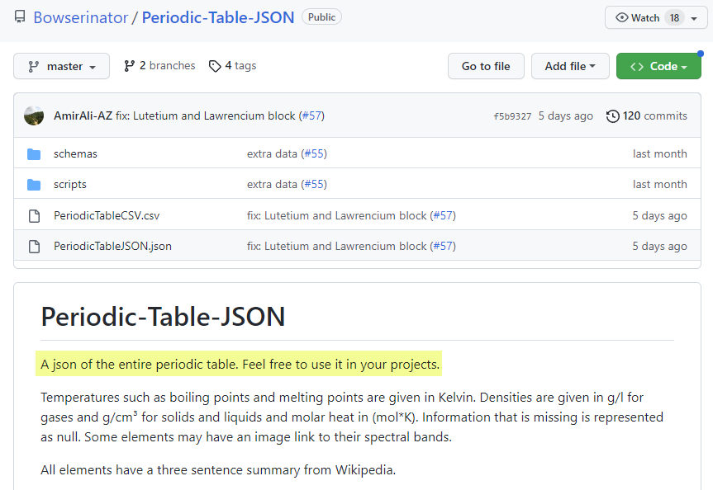
The Periodic Table as JSON
https://github.com/Bowserinator/Periodic-Table-JSON
①

Slide 36
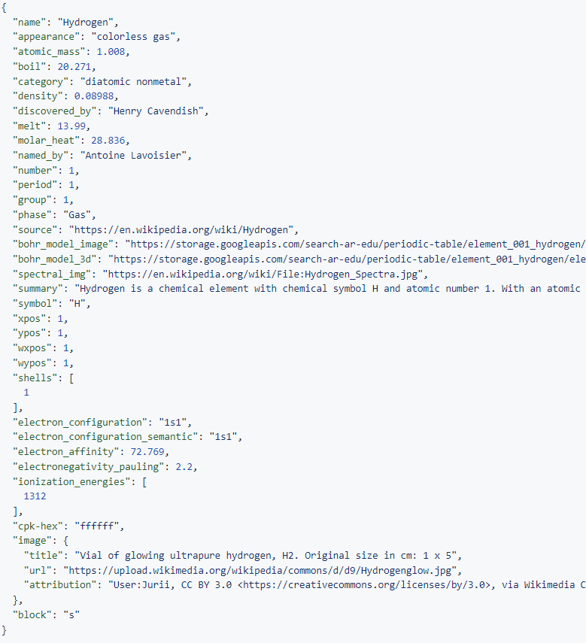
⑥
periodic_table.json
⑤
JSON is like a
Python dictionary with keys and values
②
④
③
①
A value can itself be a "nested" dictionary

Slide 37
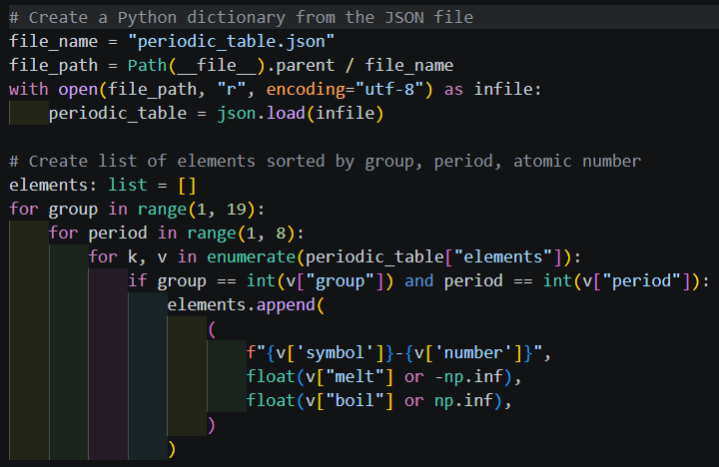
Open plot_liquid_range.py
①
②
③
④
⑤
⑥
⑦
⑧
⑨
⑩

Slide 38
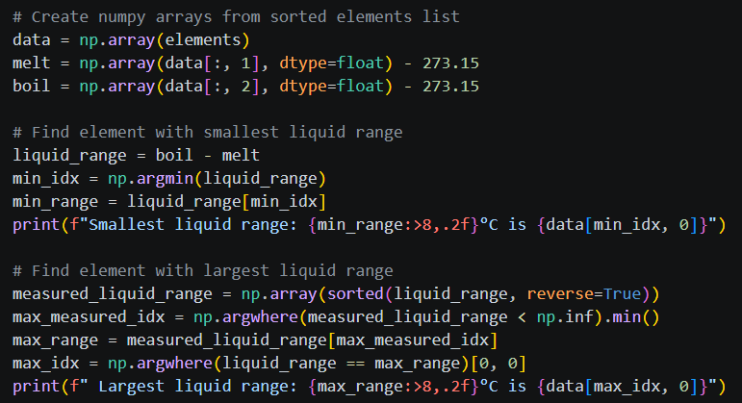
View plot_liquid_range.py
①
②
③
④
⑥
⑤
⑦
⑧
⑨
⑩

Slide 39
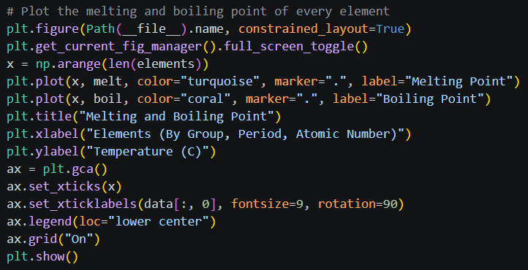
View plot_liquid_range.py
①
②
③
④
⑤
⑥
⑦
⑧
⑨
⑩

Slide 40
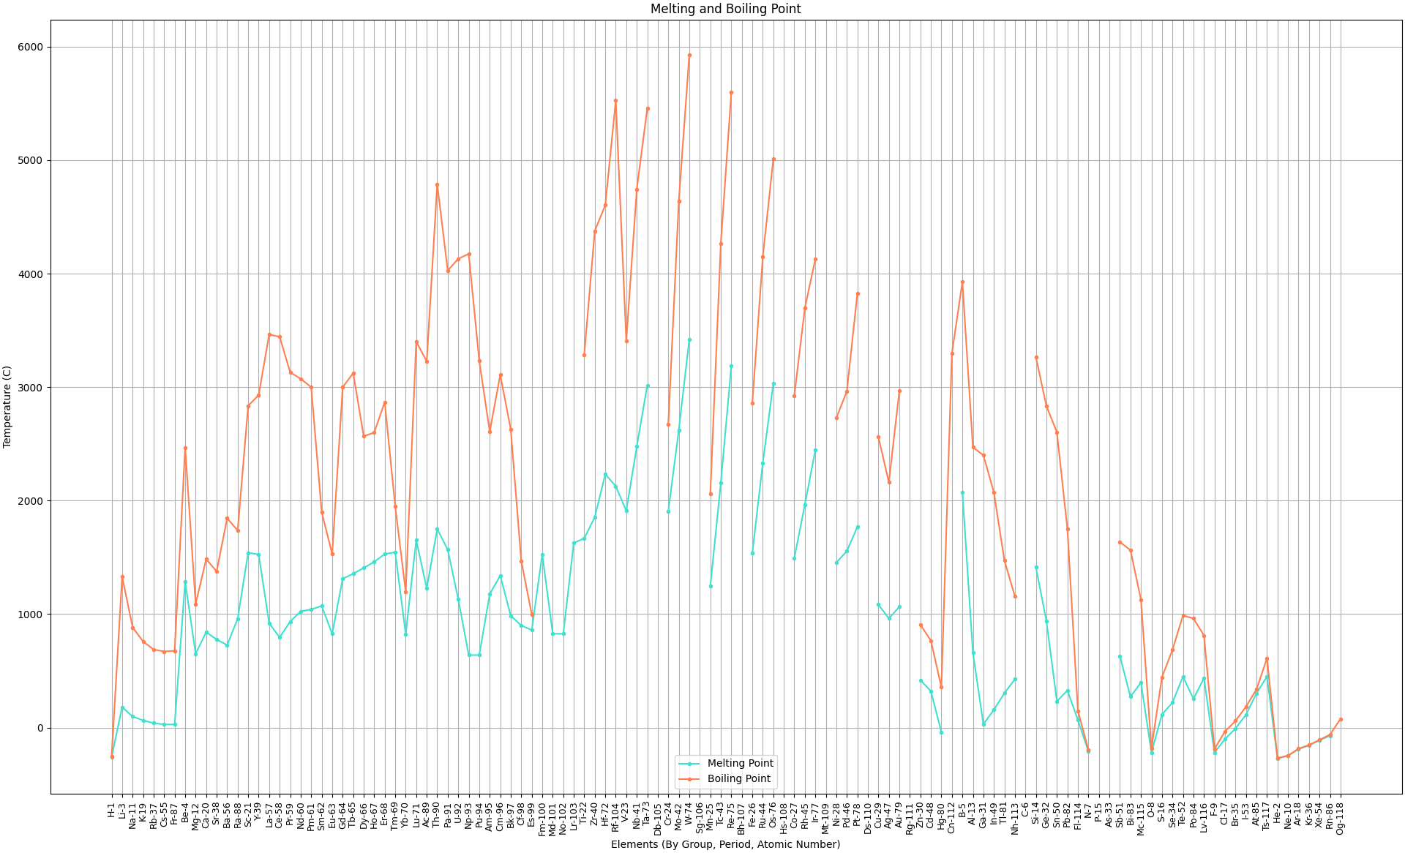

Run plot_liquid_range.py
Press q to close the plot window

Slide 41
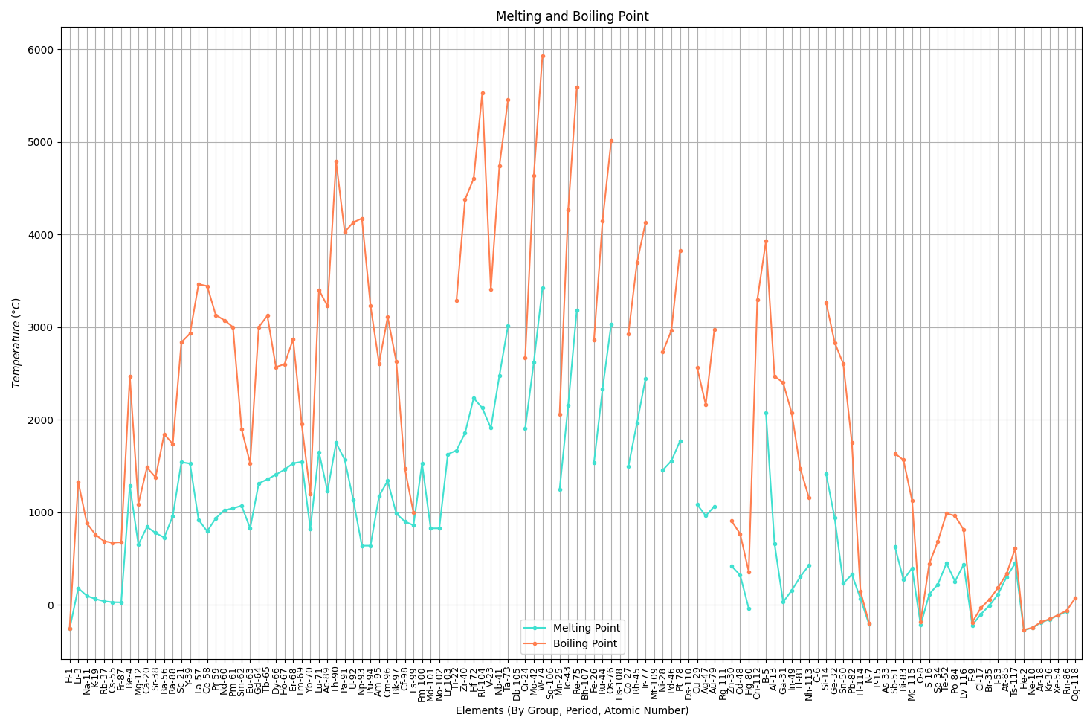
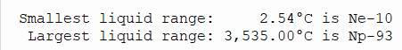
Neptunium has the largest liquid range of any element
Neon has the smallest liquid range of any element

Slide 42
Carbon doesn't have a melting point – it sublimes at 1 atm
Its boiling point is estimated to be 8,700°F at 10 MPa!
Hassium-108 is currently the heaviest element for which we can measure some chemistry

Slide 43
Rutherfordium has a half-life of 48 minutes
Tungsten is too brittle for airplane wings
Tantalum is a
conflict resource
Rhenium is very rare
Osmium is ultra rare
Zirconium reacts with water at high temperatures At Mach 3 airplane skin
temperatures reach 900 °C
Hafnium spontaneously combusts when exposed to air
Titanium has excellent
ductility and strength!
What material should we use to build a
supersonic airplane?

Slide 44
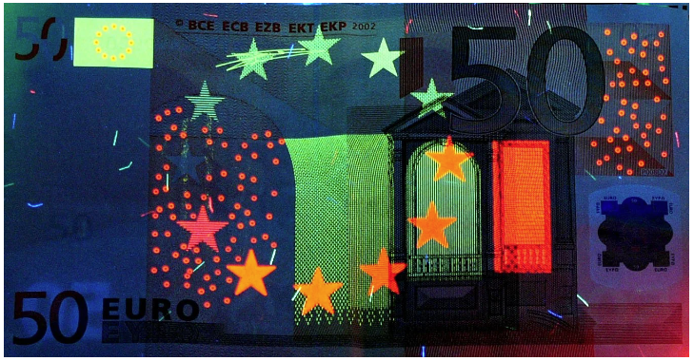

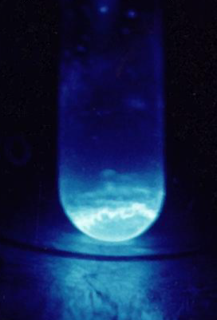
Beryllium is 50% stronger than steel
Liquid-fuel rockets use nozzles of pure beryllium
Europium is used to identify counterfeit Euros
Ytterbium is used to make flexible (fiber) lasers
Einsteinium produces 1000W of heat per gram

Slide 45
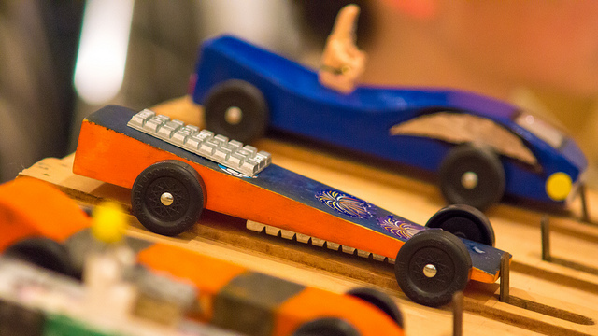

How Energetic is Einsteinium?
5 oz
190 hp
2019 Mazda Miata
$$\frac{5oz}{1}×\frac{28.35g}{1oz}×\frac{1kW}{1g}=141.7kW$$
Einsteinium produces 1000W of heat per gram
$$\frac{141.7kW}{1}×\frac{1.34hp}{1kW}=190.02hp$$
Five pounds of Einsteinium would power a Miata continuously for a whole year!
vs. 2,835 pounds of gasoline

Slide 46
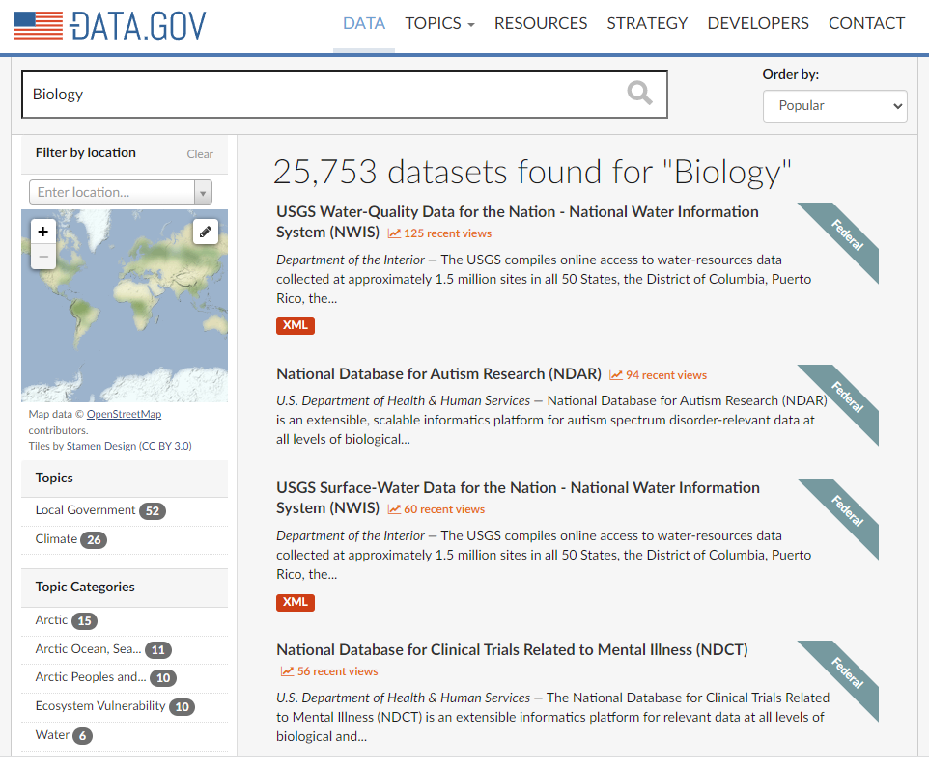
DATA.GOV
https://catalog.data.gov

Slide 47
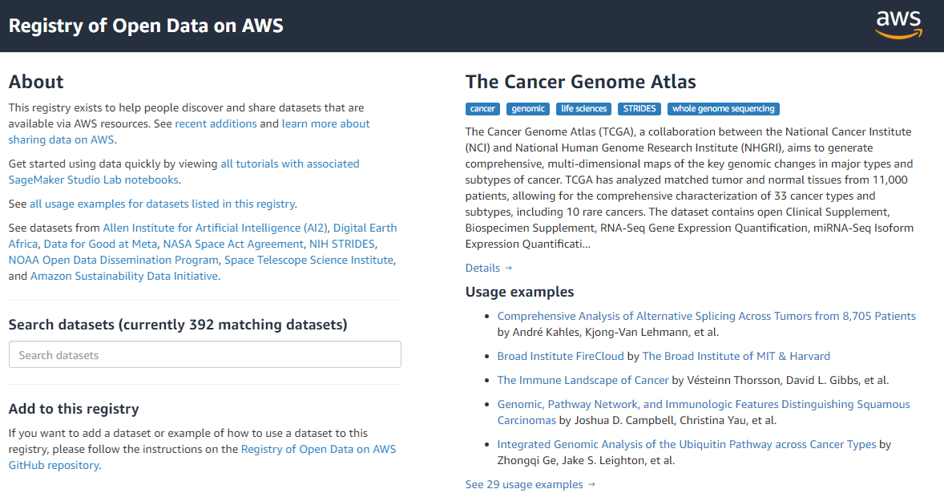
Amazon Open Data Sets
https://registry.opendata.aws

Slide 48
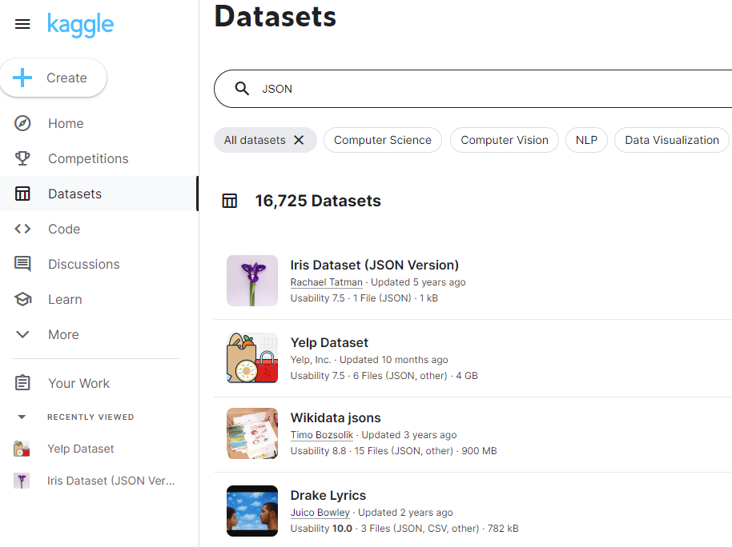
Kaggle
https://www.kaggle.com/datasets

Slide 49
Web Scraping
Not all valuable available online data sources are readily packaged as CSV or JSON files
Some potentially instrumental data sources exist purely as static HTML web pages on the public Internet
Newer and more complicated web pages may be dynamically rendered using JavaScript libraries such as AJAX, React, and Node.js
We need a way for our Python script to pretend to be a web browser, visit a website, and mimic a human manually surfing the site’s data-centric webpages while extracting crucial information from the returned HTML

Slide 50
Web Scraping
https://www.selenium.dev
The free & open-source library Selenium allows your Python script to programmatically drive web browsers to extract the HTML that is rendered by the target website
The Selenium library is a tool for automating web browser interactions, commonly used for testing web applications
Selenium supports major browsers (Chrome, Firefox, Safari, etc.) and works across different operating systems
Selenium mimics web page interaction & parsing, which includes allowing navigation, form submission, and page content extraction (e.g., text, attributes) by interacting with the underlying HTML document object model (DOM)

Slide 51
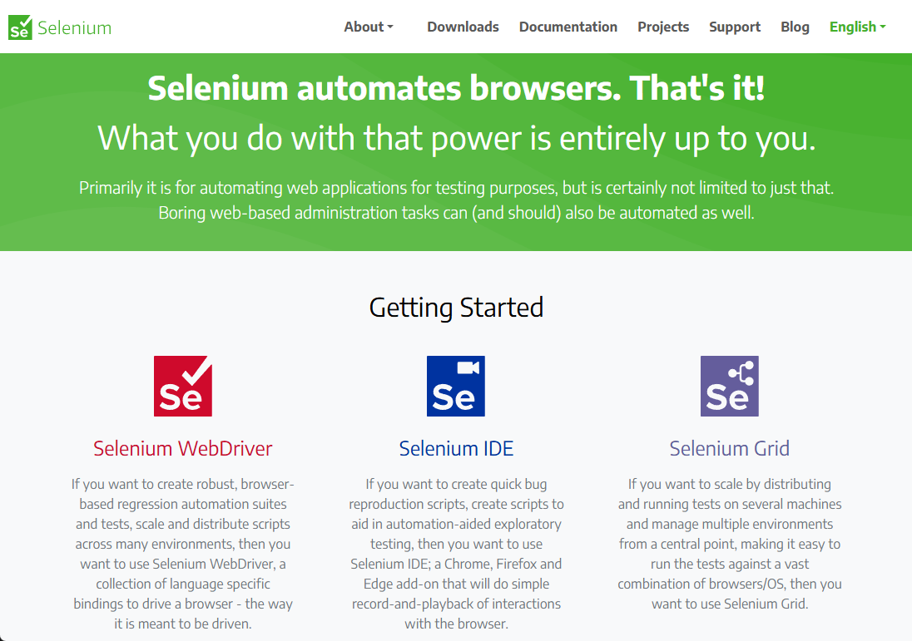
Web Scraping
https://www.selenium.dev

Slide 52
Web Scraping
Once Selenium obtains (from the driven web browser) the fully rendered HTML web page, including content that was rendered dynamically via JavaScript, we can then parse the returned HTML tags
Web pages can be interpreted as a document object model (DOM), giving us a structured way to extract content wrapped in HTML tags such as:
<table> to identify the start of the table
<th> to identify a table column header within a table
<tr> to identify the start of a table row within a table
<td> to identify table data (a “column”) within a table row

Slide 53
Web Scraping
https://www.crummy.com/software/BeautifulSoup
The Python package Beautiful Soup provides an object-oriented approach to enumerating the DOM that represents the hierarchical HTML tags in a parsed web page
Flexible and Tolerant: It can handle poorly formatted or broken markup (e.g., missing tags), making it ideal for scraping real-world web pages that aren’t always well-structured
Simple Navigation & Search: It provides intuitive methods to search for tags, attributes, and text using tag names, CSS selectors, or regular expressions—great for quickly locating specific content
Beautiful Soup automatically converts incoming documents to Unicode and outgoing documents to UTF-8. You don't have to think about encodings

Slide 54
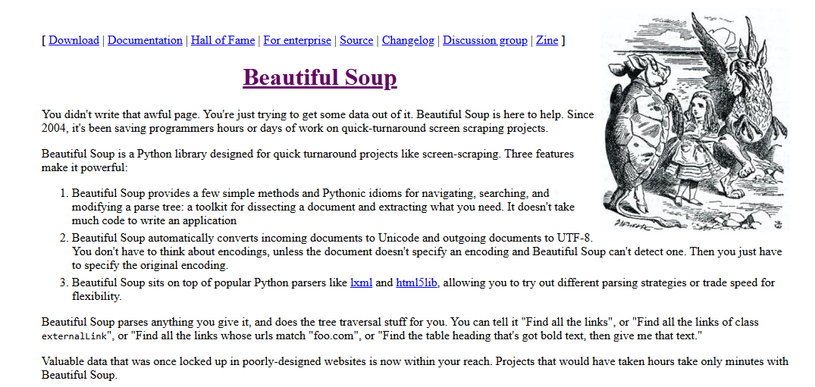

Web Scraping
https://www.crummy.com/software/BeautifulSoup
Sung by Mock Turtle

Slide 55
Web Scraping
Your scientist needs you to list the top 10 elements with the highest electrical conductivity
Unfortunately, there is no readily available (free and open-source) periodic table of the elements containing this information that is conveniently packaged in CSV or JSON
You have found a public Internet web page that contains the information you need, but that data is rendered dynamically using JavaScript (not as a static web page)
By using Selenium and Beautiful Soup, you should be able to parse the element data on that web page and then sort it by electrical conductivity

Slide 56
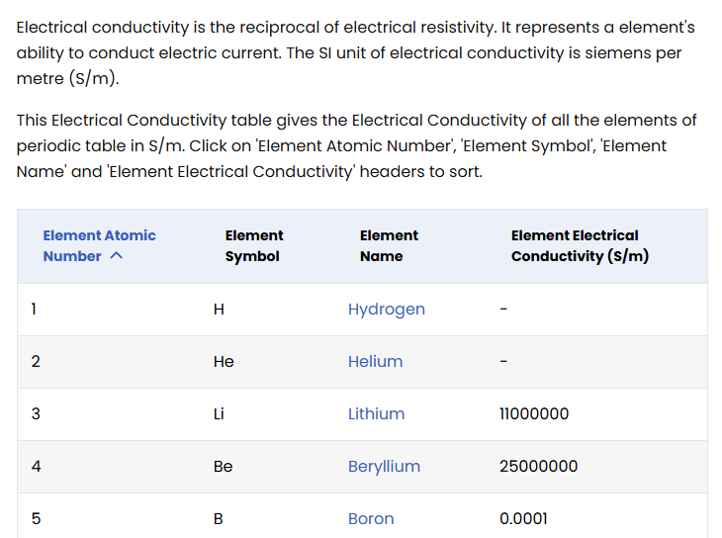
Web Scraping
Electrical Conductivity of all the elements in the Periodic Table
We will extract this data directly from the web page and use it for our data analysis!
Siemens per meter

Slide 57
Web Scraping
Start
Script
Selenium WebDriver Setup
driver.get(url)
Launches Chrome
WebDriverWait for <table>
BeautifulSoup builds DOM from driver.page_source
BeautifulSoup scans for <table>, <th>, <tr>, <td>
BeautifulSoup returns content as Python lists
Pandas creates dataframe using the headers and table rows
Pandas converts the electrical conductivity to a numeric column
Pandas removes any rows missing a value for electrical conductivity
Pandas sorts the rows in decreasing conductivity and then takes the top 10 rows
Pandas adds a column to store the ordinal ranking of each remaining row
Pandas displays the dataframe

Slide 58
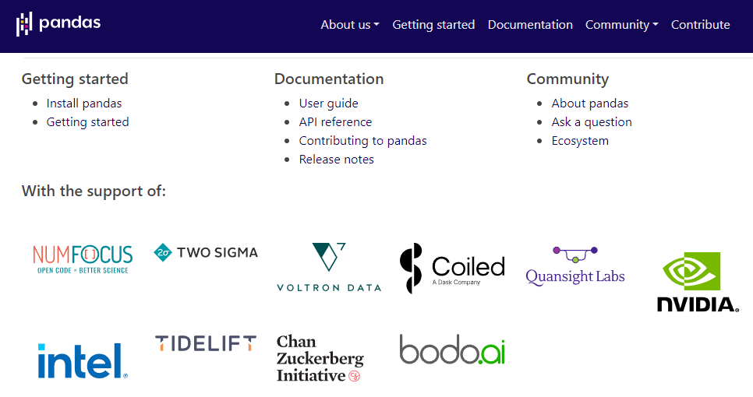
Extending Python via the pandas Package
https://pandas.pydata.org

Slide 59
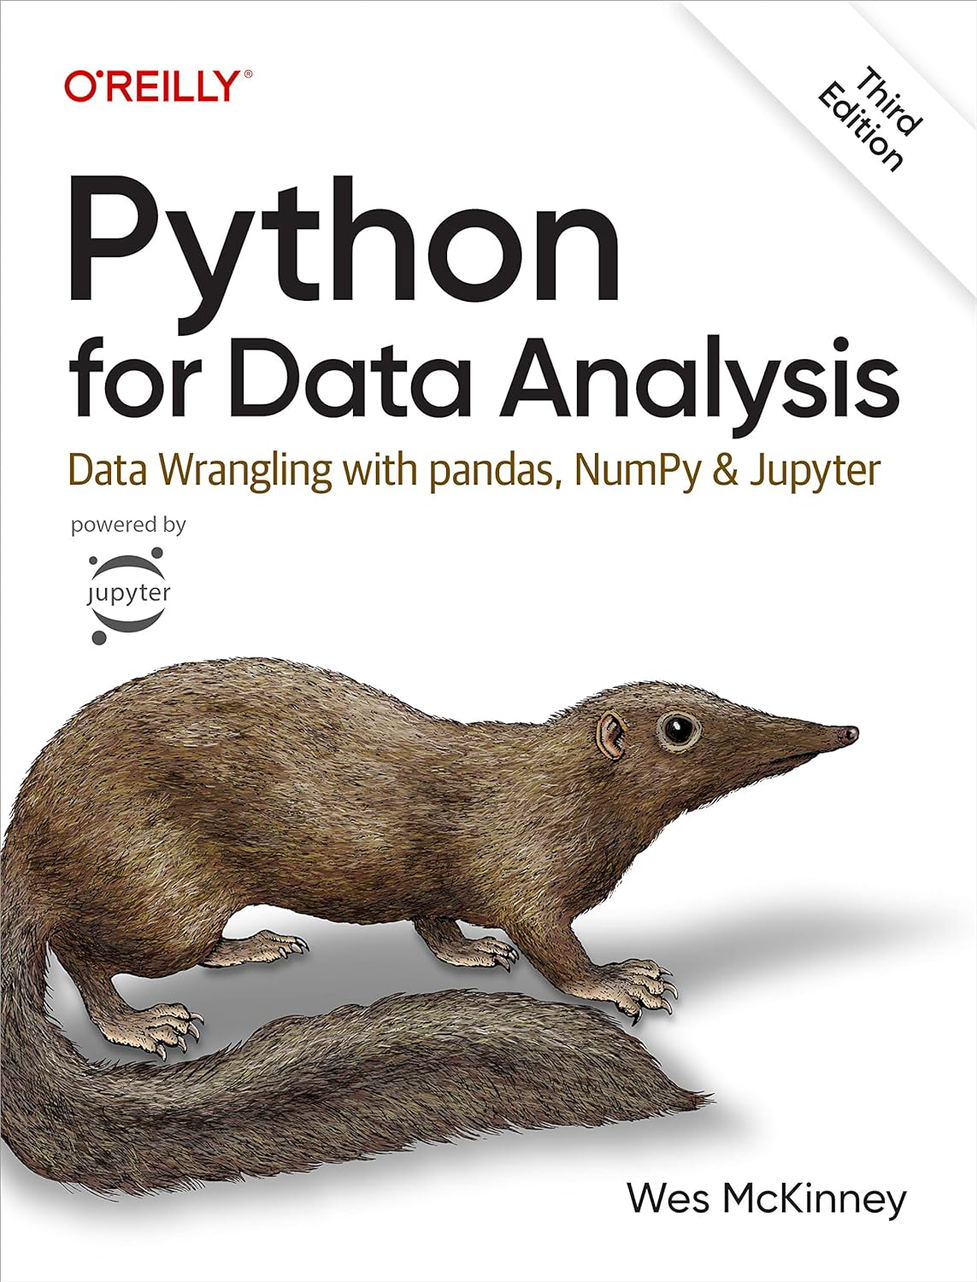

Extending Python via the pandas Package
Pandas is 100% Open Source and Free of Cost

Slide 60
Lab Setup
This lab has two slightly different Python scripts
You will only run one, based on your Operating System (Windows or macOS) and your installed web browser (Google Chrome or Apple Safari)
Don’t worry if you are unable to run this lab on your workstation/laptop – it is not crucial for this workshop
But interns at all US National Labs are often required to obtain data from both internal and public websites that may exist solely as static or dynamic web pages, not just formatted data like CSV/JSON or SQL databases

Slide 61
Lab Setup
If you are running Microsoft Windows, there is no special additional setup required to run this lab
If you are running on macOS, open an iTerm2 shell session and execute this command: safaridriver --enable

Slide 62
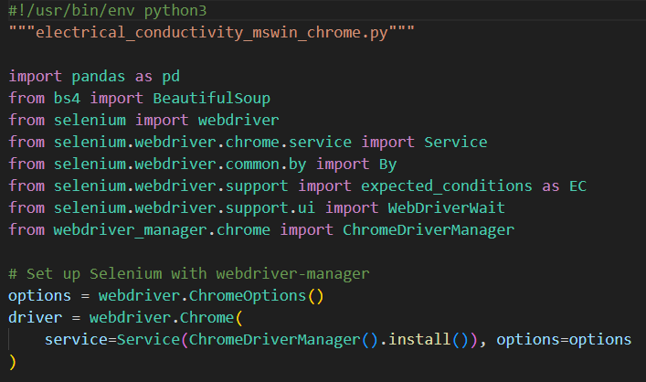
Open electrical_conductivity_mswin_chrome.py
①
②
③
④
We could set additional options
⑤

Slide 63
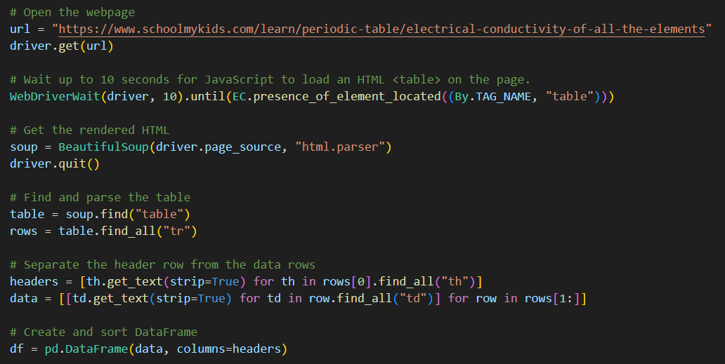
View electrical_conductivity_mswin_chrome.py
①
②
③
EC = expected condition
④
⑤
⑥
⑦
A Python List comprehension
⑧
⑨
A nested Python List comprehension
⑩

Slide 64
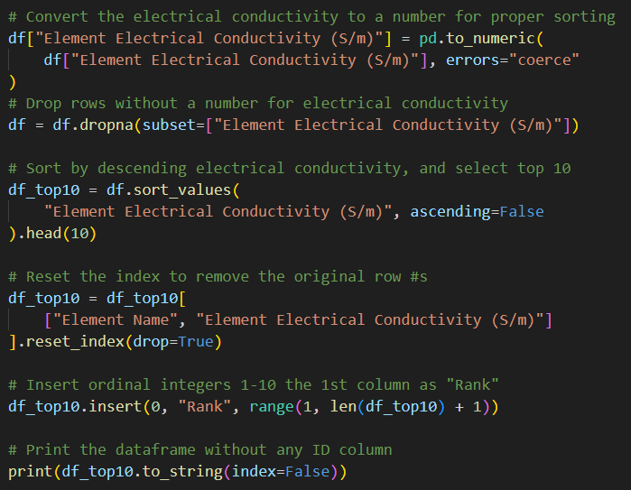
View electrical_conductivity_mswin_chrome.py
①
②
③
④
⑤
⑥
⑦

Slide 65

Run your version of the script!
}
Top 4 make sense…
Chalky white bones are made from Calcium!
Do bones conduct electricity?

Slide 66

Run your version of the script!

Slide 67


Consider Wolfram Mathematica
One line of code to query, sort, and nicely display the same data!
Mathematica provides instant access to the online Wolfram Data Repository
A $90 Raspberry Pi 5 with 4GB of RAM (Adafruit, Amazon) comes with a fully licensed version of Mathematica, for free!

Slide 68

Consider Wolfram Mathematica
https://datarepository.wolframcloud.com

Slide 69


Consider Wolfram Mathematica
https://datarepository.wolframcloud.com
Thousands of highly curated datasets are instantly available inside Mathematica.
No web scraping or CSV/JSON parsing required!

Slide 70

Consider Wolfram Mathematica
Draw the decay chain for unstable isotopes having a mass number between 100 and 102 inclusive

Slide 71

Consider Wolfram Mathematica
Our JSON file only had the isotopes in the purple boxes

Slide 72



Balancing Ionic Equations
Can we write a program to balance ionic equations?

Slide 73


Balancing Ionic Equations
Yikes - and this is not even ionic!

Slide 74

How Hard Can It Be?
$$P_{2}I_{4}+P_{4}+H_{2}O→PH_{4}I+H_{3}PO_{4}$$
Please Balance This Equation
This Diphosphorus Tetraiodide reaction is fundamental to respiration

Slide 75


Chemistry is Optimization
Consider a chemical formula as an optimization problem:
$$MnO_{4}^{−}+H_{2}O_{2}+H^{+}→{Mn}^{2+}+O_{2}+H_{2}O$$
$$x_{0}MnO_{4}^{−}+x_{1}H_{2}O_{2}+x_{2}H^{+}→x_{3}{Mn}^{2+}+x_{4}O_{2}+x_{5}H_{2}O$$
Develop the objective function and the constraints:
$$obj: minimize \sum_{i=0}^{n}{x_{i}}$$
due to Principle of Atom Conservation (POAC)
$$\left\{x_{i}∈ℤ^{+}\right\}$$

Slide 76
Encoding a Chemical Equation
We can encode a chemical reaction using a system of linear equations
There will be one unknown for every molecule (or charged ion)
There will be one equation for every element (atom)
We may need one more equation to encode the ionic charges
The integer program solver will emit the coefficients for each term in the chemical equation
We are looking for the optimal (minimal) solution to the system of equations due to POAC
The solutions must be positive integer values because elements combine in whole numbers, and we do not write any reactants or products with a zero coefficient

Slide 77

Chemistry is Optimization
$$MnO_{4}^{−}+H_{2}O_{2}+H^{+}→{Mn}^{2+}+O_{2}+H_{2}O$$
$$x_{0}MnO_{4}^{−}+x_{1}H_{2}O_{2}+x_{2}H^{+}→x_{3}{Mn}^{2+}+x_{4}O_{2}+x_{5}H_{2}O$$
$$obj: minimize \sum_{i=0}^{n}{x_{i}}$$

Slide 78

Chemistry is Optimization
$$MnO_{4}^{−}+H_{2}O_{2}+H^{+}→{Mn}^{2+}+O_{2}+H_{2}O$$
$$x_{0}MnO_{4}^{−}+x_{1}H_{2}O_{2}+x_{2}H^{+}→x_{3}{Mn}^{2+}+x_{4}O_{2}+x_{5}H_{2}O$$
$$obj: minimize \sum_{i=0}^{n}{x_{i}}$$
$$x_{0}=x_{3}$$ | To balance the Manganese (Mn)
$${4x}_{0}+2x_{1}={2x}_{4}+x_{5}$$ | To balance the Oxygen (O)
$${2x}_{1}+x_{2}={2x}_{5}$$ | To balance the Hydrogen (H)
$${−x}_{0}+x_{2}={2x}_{3}$$ | To balance the charges

Slide 79


Chemistry is Optimization
We have transformed solving a chemical equation into a solving a linear optimization problem
The Simplex method is a known good approach to solve linear programming problems in reasonable time
However, managing slack variables and the tableau algorithm can be intimidating for novice programmers
Instead, we will utilize a Python Linear Program library (PuLP) to quickly find the optimal solution over the integers

Slide 80

Chemistry is Optimization
https://ergo-code.github.io/HiGHS/dev

Slide 81

Open balance_eqn1.py
①
②
One decision variable for each molecule

Slide 82

View balance_eqn1.py
①
②
③
④
One constraint for each atom (and charges if required)
Reactants on the left-hand side of the double equal sign
Products on the right-hand side of the double equal sign

Slide 83


View balance_eqn1.py
①
②
③
④

Slide 84


Run balance_eqn1.py
①
②
③
⑤
$2HNO_{3}+Ca{\left(OH\right)}_{2}$ $→Ca{\left(NO_{3}\right)}_{2}+{2H}_{2}O$
④

Slide 85

Open balance_eqn2.py
$${x_{0}C}_{7}H_{6}O_{2}+{x_{1}O}_{2}→x_{2}CO_{2}+{x_{3}H}_{2}O$$
①
②
③
④

Slide 86

Run balance_eqn2.py
$${x_{0}C}_{7}H_{6}O_{2}+{x_{1}O}_{2}→x_{2}CO_{2}+{x_{3}H}_{2}O$$
$${2C}_{7}H_{6}O_{2}+{15O}_{2}→14CO_{2}+{6H}_{2}O$$

Slide 87

Open balance_eqn3.py
$$x_{0}MnO_{4}^{−}+x_{1}H_{2}O_{2}+x_{2}H^{+}→x_{3}{Mn}^{2+}+x_{4}O_{2}+x_{5}H_{2}O$$
①
②

Slide 88

Run balance_eqn3.py
$$x_{0}MnO_{4}^{−}+x_{1}H_{2}O_{2}+x_{2}H^{+}→x_{3}{Mn}^{2+}+x_{4}O_{2}+x_{5}H_{2}O$$
①
$$2MnO_{4}^{−}+H_{2}O_{2}+{6H}^{+}→2{Mn}^{2+}+3O_{2}+4H_{2}O$$
②

Slide 89

Open balance_eqn4.py
$${Cr}_{2}O_{7}^{2−}+H^{+}+H_{2}C_{2}O_{4}→{Cr}^{3+}+H_{2}O+CO_{2}$$
$$x_{0}{Cr}_{2}O_{7}^{2−}+x_{1}H^{+}+x_{2}H_{2}C_{2}O_{4}→x_{3}{Cr}^{3+}+x_{4}H_{2}O+x_{5}CO_{2}$$
①
②

Slide 90

Run balance_eqn4.py
$${Cr}_{2}O_{7}^{2−}+H^{+}+H_{2}C_{2}O_{4}→{Cr}^{3+}+H_{2}O+CO_{2}$$
$$x_{0}{Cr}_{2}O_{7}^{2−}+x_{1}H^{+}+x_{2}H_{2}C_{2}O_{4}→x_{3}{Cr}^{3+}+x_{4}H_{2}O+x_{5}CO_{2}$$
$${Cr}_{2}O_{7}^{2−}+8H^{+}+3H_{2}C_{2}O_{4}→2{Cr}^{3+}+7H_{2}O+6CO_{2}$$

Slide 91



Run balance_eqn5.py
$$MnO_{4}^{−}+{Fe}^{2+}+H^{+}→{Mn}^{2+}+{Fe}^{3+}+H_{2}O$$
$$MnO_{4}^{−}+5{Fe}^{2+}+8H^{+}→{Mn}^{2+}+{5Fe}^{3+}+4H_{2}O$$

Slide 92


Run balance_eqn6.py
$$P_{2}I_{4}+P_{4}+H_{2}O→PH_{4}I+H_{3}PO_{4}$$
$$x_{0}P_{2}I_{4}+x_{1}P_{4}+x_{2}H_{2}O→x_{3}PH_{4}I+x_{4}H_{3}PO_{4}$$
This Diphosphorus Tetraiodide reaction is fundamental to respiration
Respiration requires much water
$${10P}_{2}I_{4}+13P_{4}+{128H}_{2}O→40PH_{4}I+32H_{3}PO_{4}$$

Slide 93

Chemistry is Optimization
https://www.webqc.org/balance.php
The backend processor for this web page uses the exact approach we have covered in this lab!

Slide 94
Session 25 – Now You Know…
Numpy can easily load, parse, and save comma-separated value (CSV) data files and treats them as arrays
A dictionary in Python stores a series of key-value pairs, with the key and the value separated by a colon
Dictionary keys can be any immutable type (int, float, str, tuples) while values can be any type, including another dictionary
A JavaScript Object Notation (JSON) file follows the same syntax as a Python Dictionary
We can encode a chemical equation as a linear program
There is an unknown for every molecule and an equation for every atom (and if applicable, one equation for charge)
We can solve integer optimization problems using the PuLP module

Slide 95
TASK 25
Create a Python file called octane_combustion.py
Using the code in the stoichiometry examples as a model, write new code that balances the chemical reaction representing the combustion of unleaded automobile gasoline

